Slide 1
MICRODATA BASE OF SUSTAINABILITY INDICATORS (esg) DEVELOPED AT BANCO DE ESPAÑA USING AI TOOLS
Natividad Pérez Martín
Borja Fernández-Rosillo San Isidro
Central Balance Sheet Data Office
Statistics Department
56th WCARS (World continuous Auditing and reporting Symposium)
ALCALÁ 48
27/04/2023
Directorate general economics, statistics and research

Slide 2
INDEX
Introduction and context
Researching and establishing the relevant indicators
Creation of the ESG database prototype
Quality control
Improvement of the supervised learning system
Main results
Data gaps and limitations
Conclusions
ANNEX: ESG database resources at disposal in BdE website
Directorate general economics, statistics and research

Slide 3


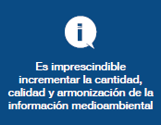

1. INTRODUCTION AND CONTEXT
Why does this need arise?
Measure the exposure of the Spanish Economy to climate change at a disaggregated level
Analyse the implications of climate change and transition to a more sustainable economy
Evaluate the impact of economic policy measures on climate change
Facilitate the channelling of investment towards environmentally friendly activities
NEED FOR A GRANULAR DATABASE ON ESG INFORMATION
It is essential to increase the quantity, quality and harmonization of Environmental information
Directorate general economics, statistics and research

Slide 4



1. INTRODUCTION AND CONTEXT
Most limiting aspects in current and future regulations
Spanish Law 11/2018 on non-financial information and diversity
CSRD¹ (Corporate Sustainability Reporting Directive)
MAIN CURRENT LIMITATIONS
1
ONLY GROUPS? EXEMPTION FOR SUBSIDIARIES
EFRAG - ESRS (European Sustainability Reporting Standards)
2
HETEROGENEITY OF REPORTED INDICATORS
3
LACK OF DIGITALIZATION
Information available in XBRL format
4
LIMITED POPULATION (SMALL AND MEDIUM OUTSIDE)
TWO IMPORTANT LIMITATIONS REMAIN WITH THE NEW CSRD
¹ CSRD was approved by the European Council in November 2022 and is currently under transposition phase
Directorate general economics, statistics and research

Slide 5









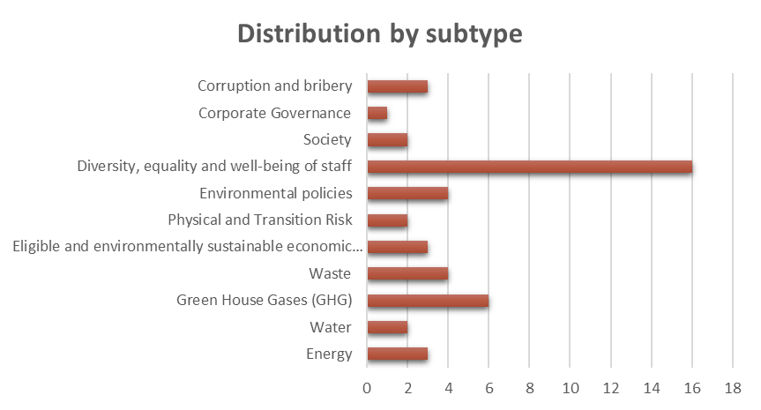
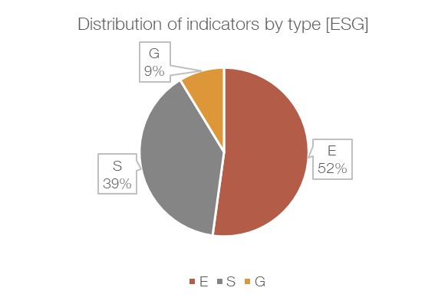
2. Researching and establishing the relevant indicators
Main aspects taken into consideration
1. Analysing the current regulatory obligations
2. Researching the national and international ESG standards
3. Establishing a preliminary list of 124 indicators
4. Conducting a practical research exercise involving six listed companies
Non-Financial Reporting Directive (Directive 2014/95/EU that was transposed into Spanish law by Ley 11/2018)
In the future CSRD will be transposed and will update Ley 11/2018
List of preliminary indicators
TOTAL | 124
E-Environmental | 62
S-Social | 44
G-Governance | 18
5. List of 46 ESG indicators to search for
E
S
G
46
Directorate general economics, statistics and research

Slide 6
2. Researching and establishing the relevant indicators
List of indicators for searching
TYPE E
24
9
33
TYPE S
18
TYPE G
4
Energy consumption within the org.
% of turnover taxonomy eligible
Employees
ENERGY
Reduction of energy consumption
% of CAPEX taxonomy eligible
Average age of employees
Board average remuneration
% renewable energy among the total
% of OPEX taxonomy eligible
Gender diversity
Crime Prevention Policy
Water consumption
% of turnover taxonomy aligned
% of turnover taxonomy aligned – climate change mitigation
Gender diversity on the board
Nº corruption and bribery complaints
WATER
Company located in a stress area regarding water
Average wage gap
% of turnover taxonomy aligned – climate change adaptation
Work stability
Complaint channel
Direct GHG emissions (scope 1)
Eligible and environmentally sustainable economic activities – KPIs according to EU TAXONOMY
Disability
Indirect GHG emissions when generating energy (scope 2)
% of CAPEX taxonomy aligned
% of CAPEX taxonomy aligned – climate change mitigation
Absenteeism
EMISSIONS (GHG)
Scope 2 – calculation method
Other indirect GHG emissions (scope 3)
% of CAPEX taxonomy aligned – climate change adaptation
Employee rotation
GHG emissions intensity
% of OPEX taxonomy aligned
Employee training
E
S
G
Reduction of GHG emissions
% of OPEX taxonomy aligned – climate change mitigation
Number of layoffs
ESG supplier selection policy
Reconciliation measures
46
9
55
Environmental Policy
% of OPEX taxonomy aligned – climate change adaptation
Human Rights Policy
POLICY
Circular Economy
Analyze Physical Risks
Equality plan
ISO14001 regulatory compliance
Physical and Transition risk
Diversity plan
9 New indicators to look for on next search
Non-hazardous waste
9
Analyze Transition Risks
Health and safety policy
WASTE
Waste generated
Payment to suppliers
Waste not destined for disposal
Customer satisfaction level
Hazardous waste
Directorate general economics, statistics and research

Slide 7
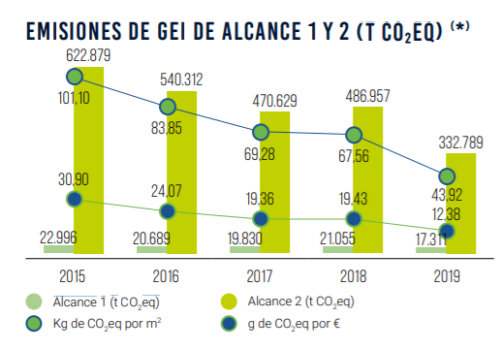
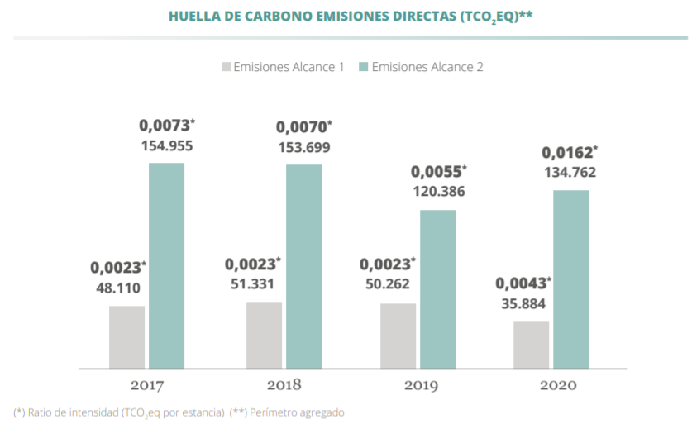

3. CREATION OF THE ESG DATABASE PROTOTYPE
What information are we looking for? How it is presented?
ANUAL CONSOLIDATED ACCOUNTS FROM MELIA
INDITEX NON-FINANCIAL STATEMENTS
Same information but heterogeneously presented, how can deal with it?:
Develop a web application prototype for information retrieval and storage
Create a specific ontology (dictionary of ESG words)
ANUAL CONSOLIDATED FINANCIAL STATAMENTS FROM TELEFONICA
Directorate general economics, statistics and research

Slide 8
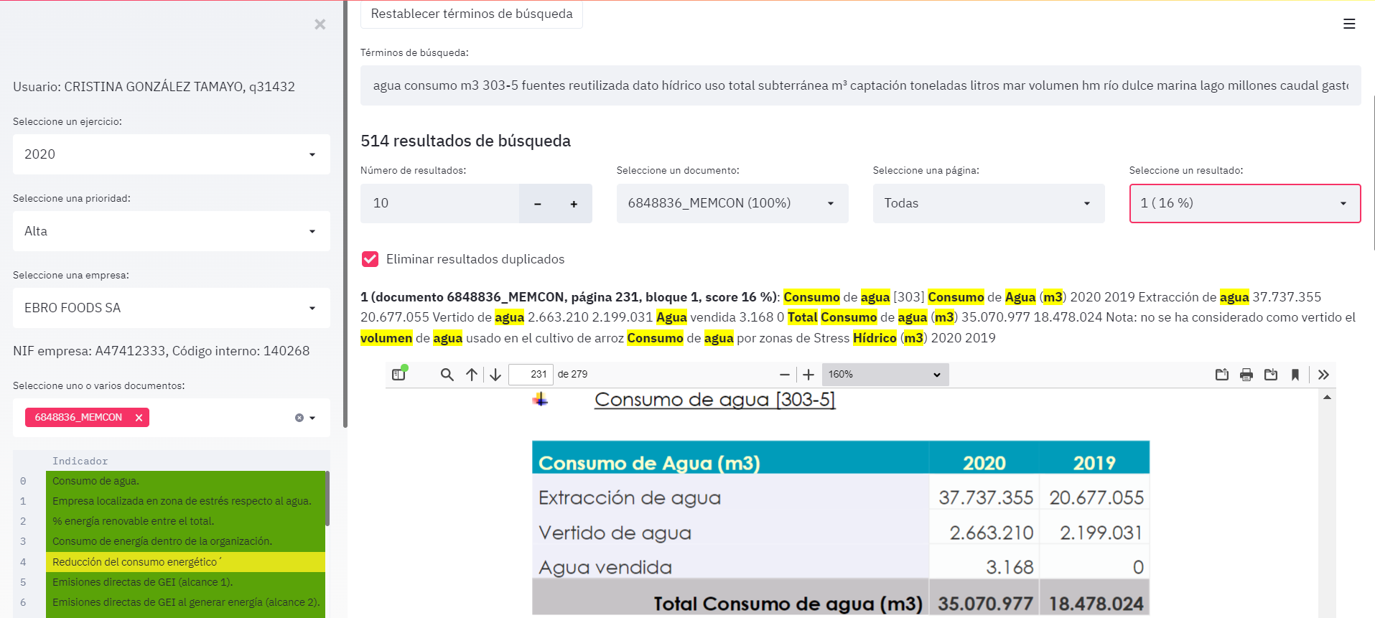

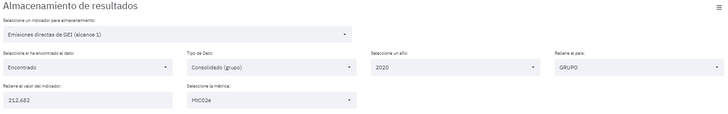
3. CREATION OF THE ESG DATABASE PROTOTYPE
Prototype developed
A web application with (semi-automatic) full-text search and storage capabilities has been developed.
The user selects a year, company and indicator.
The tool searches the ontology in company documents and presents an ordered list of paragraphs in order of relevance.
The user validates the search results and stores the indicator value into the database.
Context information (user, data, page and paragraph, terms and search results…) is saved, which will serve to improve the automation in the search process.
1
2
2
1
1
4
3
4
3
Directorate general economics, statistics and research

Slide 9
4. Quality control
Relevance of the review process
PURPOSE OF THE REVIEW
The objective of the review carried out is: 1) To ensure that the information collected is as coherent, reliable and precise as possible and 2) To learn the behaviour and case studies of the different indicators with the objective to improve the application, in the process of loading data and future quality controls.
STRUCTURE OF THE REVIEW
1
FOR NUMERICAL INDICATORS
(take value)
2
FOR NON-NUMERICAL INDICATORS
(categorical result)
Individual data-by-data analysis
Verification of metric, values, consistency with sector and historical series.
Review and analysis of the most common metric to establish it as the homogeneous metric.
Elimination of duplicities between exercises.
Preparation of tables on behaviour by sector and year.
Collection of examples in memory.
Consistency
Random data analysis.
Checking for inconsistencies between years (“YES” one year and “NO” the next or vice versa).
Approximate analysis of the degree of success in the search for that indicator.
Compilation of examples in memory.
Historical data
Homogenize
Common metric
Duplicities
OUTPUT 1 [ECONOMIC ANALYSIS]: INFORMATION BY SECTOR AND YEAR FOR EACH INDICATORS
Analysis
OUTPUT 2 [FOUND / NOT FOUND ANALYSIS]: INFORMATION BY SECTOR AND YEAR FOR EACH INDICATOR
Coherence
Examples
Guide´s preparation
Analysis of: (1) Total sum / (2) Nº of companies / (3) Mean by sector/year / (4) Max/Min
…
Analysis of: (1) Total not found / (2) Nº of companies found&not found /
Directorate general economics, statistics and research

Slide 10

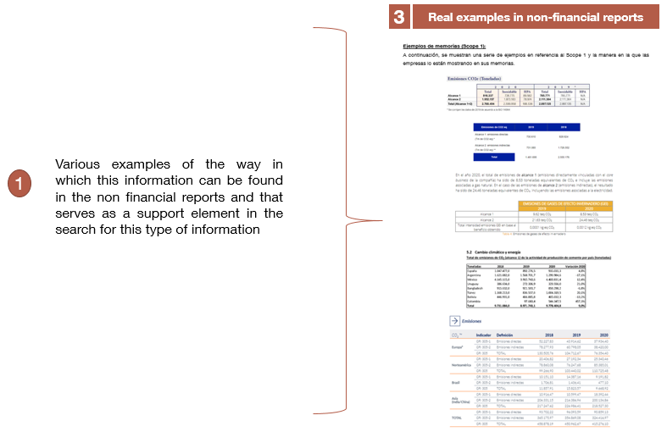
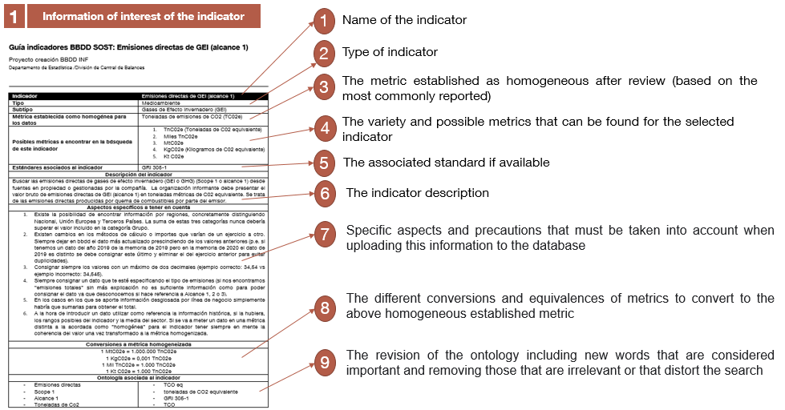
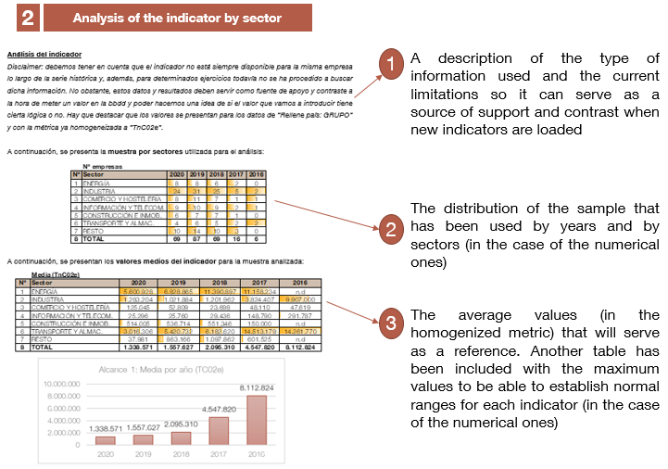
4. Quality control
Improving data: guides and videos
In order to complete the guides videos have been recorded to:
Support learning process
Share experience
Training of interns
As a result of the quality control, a big amount of considerations and peculiarities have arisen, and consequently we have created Bank of Spain ESG guides for internal use*
1
Information of interest on the indicator
2
Analysis of the indicator by sector
3
Real examples in non-financial reports
This second part of the guides relates to sample data for the indicator being analysed in order to provide a reference to establish if the new data being introduced into the database are consistent and realistic.
This third part of the guides relates to real examples of how this information can be presented in the non-financial reports in order to facilitate the location of this information.
This first part of the guides relates to general information on the indicator in order to improve the process of locating the information.
(*) To increase the accuracy and quality of future uploadings of ESG data, individual guides were prepared for each of the 39 indicators. These guides are only available for Bank of Spain technical employees involved in the process of gathering ESG data.
Directorate general economics, statistics and research

Slide 11

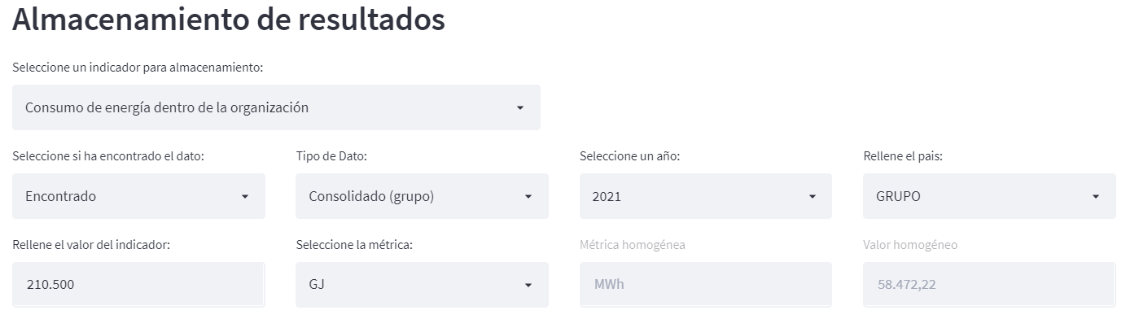


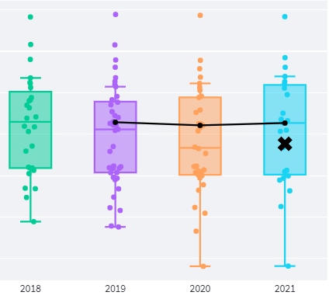
4. Quality control
New features in the app: Data comparison and standardization of metrics
Standardization of metrics
Sector and historic comparison
The new features allow to:
Analyze online the value that you want to record in the metric established as homogeneous.
Store both the original metric and the transformed value (directly available for use and exploitation).
Carry out an online comparison of the data (with companies of the same sector and with historic data of the company) before introducing it in the database.
Directorate general economics, statistics and research

Slide 12
5. IMPROVEMENT OF THE SUPERVISED LEARNING SYSTEM
Proposal, evaluation, comparison and optimization of search queries
1
What data do we have? In addition to the values of the indicators, valuable information of the context in which the indicator is reported including:
The exact location of the data in the non-financial statement (e.g. doc 34123, pg 3, paragraph 5)
The paragraph in which it has been reported “Agua dulce 428.835 449.550 453.608 Agua subterránea 6.673 89.693 40.984 Aguas subterráneas y superficiales”.
2
What can we do with this labelled data?
- Automatically optimize search terms using machine learning (ML) and natural language processing (NLP).
3
How have we done it? An strategy has been designed and implemented to propose, evaluate, compare and optimize queries:
New queries are proposed based on the context in which each indicator is reported (NLP).
A procedure and metric validation has been defined to assign a score to each query.
This method allows you to compare and optimize queries to select the optimal one for each indicator.
Directorate general economics, statistics and research

Slide 13
6. Main results
Preliminary results
Directorate general economics, statistics and research

Slide 14
6. Main results
Some examples (Scope 1&2&3, Energy and Water consumption)
Directorate general economics, statistics and research

Slide 15
7. Data gaps and limitations
ESG data gaps
1
DIFFERENT METRICS
Diversity of units of measurement that suppose a barrier to direct comparison of data.
It is necessary to convert to a homogenised unit of measurement.
EFRAG´s ESRS standards will minimize this problem by specifying a common metric.
2
CHANGES IN DATA OVER TIME
During the process it was not uncommon to see data change from one year to the next one.
These changes are probably due to the novelty of this information and the scarcity of years of experience.
3
LACK OF INFORMATION
A substantial difference was observed between the degree of success in listed companies vs unlisted companies. The overall success rate stands more than 70%
Social indicators stand out as the type of indicator with the highest degree of success
4
COMPARABILITY DIFFICULTIES
Different calculation methods for the same indicator (i.e. Scope 2 emissions by market-based or location-based method).
Most of current available information corresponds to groups (consolidated) without distinction by geographical area, making it difficult to analyse and compare national impacts.
5
LACK OF DIGITALISATION OF THE INFORMATION PRESENTED
Information presented in the non-financial reports is still not digitalised which difficult its treatment and usage.
However, the CSRD includes the digitalisation and standardisation of reporting standards.
6
LACK OF ESG VERIFICATION
No rigorous technical supervision of the information presented.
Introduction of objective and technical measures that guarantee the quality and veracity of the data presented.
Directorate general economics, statistics and research

Slide 16

8. CONCLUSIONS
Conclusions and challenges
Real data show current regulatory limits and the improvement margin.
Regulatory limits
Need of Digitalization
Harmonised
Indicators
Information granularity
Exponential importance of granular data. However, information of groups its not enough, we need individual companies.
The importance of information in electronic formats for its massive and automated treatment.
The relevance of having a homogeneous list of harmonised indicators with a clear criteria of presentation and calculus.
Directorate general economics, statistics and research

Slide 17
THANKS FOR YOUR ATTENTION
Directorate general economics, statistics and research

Slide 18
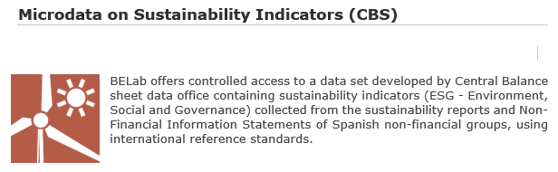


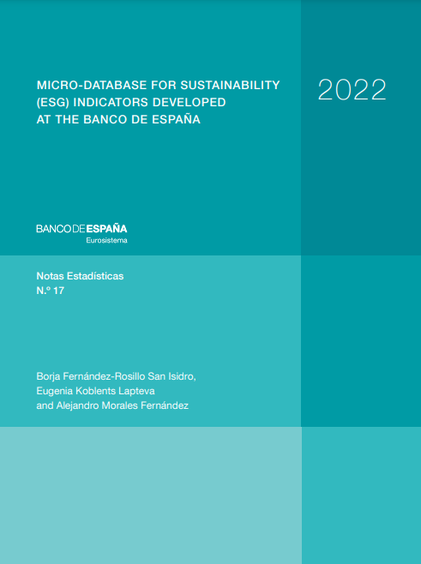
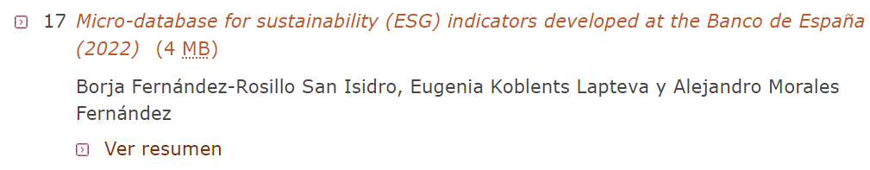
ANNEX
ESG database resources at disposal in BdE website
Microdata base at BELab:
https://www.bde.es/bde/es/areas/analisis-economi/otros/que-es-belab/
Paper: “MICRO-DATABASE FOR SUSTAINABILITY (ESG) INDICATORS DEVELOPED AT THE BANCO DE ESPAÑA”
https://www.bde.es/bde/es/secciones/informes/informacion-estadistica/notas-estadisticas/
Directorate general economics, statistics and research

